Slide 1
Hype Cycle e Magic Quandrant

Slide 2
Agenda
Conceitos Importantes
Tech Trends 2016
Hype Cycle 2017
Matrix 2017
Hype Cycle
Referências

Slide 3
Hype Cycle

Slide 4
https://www.youtube.com/watch?v=YDbkY2UoIeo

Slide 5
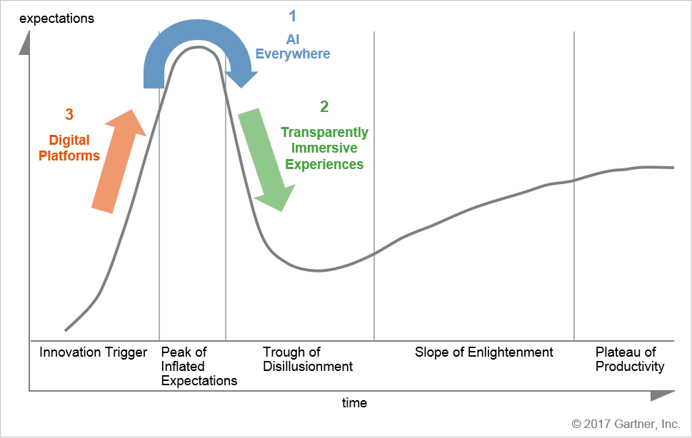
How Emerging Technology Trends Move Along the Hype Cycle
Source: Gartner (July 2017)

Slide 6
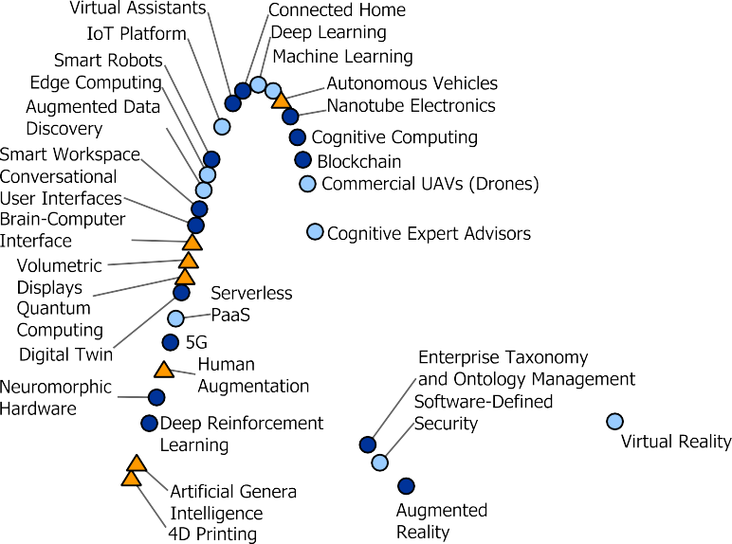

Hype Cycle for Emerging Technologies, 2017

Slide 7
Priority Matrix for Emerging Technologies, 2017
years to mainstream adoption less than 2 years 2 to 5 years 5 to 10 years more than 10 years
 | Augmented Data Discovery Cognitive Expert Advisors Deep Learning Edge Computing IoT Platform Machine Learning Software-Defined Security | Blockchain Cognitive Computing Conversational User Interfaces Deep Reinforcement Learning Digital Twin Nanotube Electronics Smart Workspace Virtual Assistants | 4D Printing Artificial General Intelligence Autonomous Vehicles Brain-Computer Interface Human Augmentation Smart Dust
 | Commercial UAVs (Drones) | 5G Augmented Reality Connected Home Neuromorphic Hardware Smart Robots | Quantum Computing
 | Serverless PaaS Virtual Reality | Enterprise Taxonomy and Ontology Management | Volumetric Displays
As of July 2017 |  |  | © 2017 Gartner, Inc.
transformational
high
moderate
low
Source: Gartner (July 2017)

Slide 8

Magic Quadrant
Source: Gartner (February 2017)

Slide 9
Referências
Gartner (2017)

